Slide 1

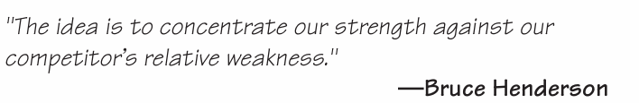
INTERNAL ASSESSMENT
Lecture Hours:50
Department of Management Studies
Visvesvaraya Technological University Belagavi-590018
umesh.bhushi@vtu.ac.in
Module#3
SUBJECT : MBA 205- CORPORATE STRATEGY
Faculty of Management Studies
VTU, Belagavi

Slide 2

COURSE OUTLINE
Lecture | Lecture Name | Lecture Hours
#1 | Module-1 Overview of strategic management | 7
#2 | Module-2 ASSESSING EXTERNAL ENVIRONMENT | 9
#3 | Module-3 ASSESSING INTERNAL ENVIRONMENT | 9
#4 | Module-4 STRATEGY FORMULATION | 9
#5 | Module-5 STRATEGY IMPLEMENTATION | 9
#6 | Module-6 STRATEGY EVALUATION | 7
 | Total Hours | 50

Slide 3
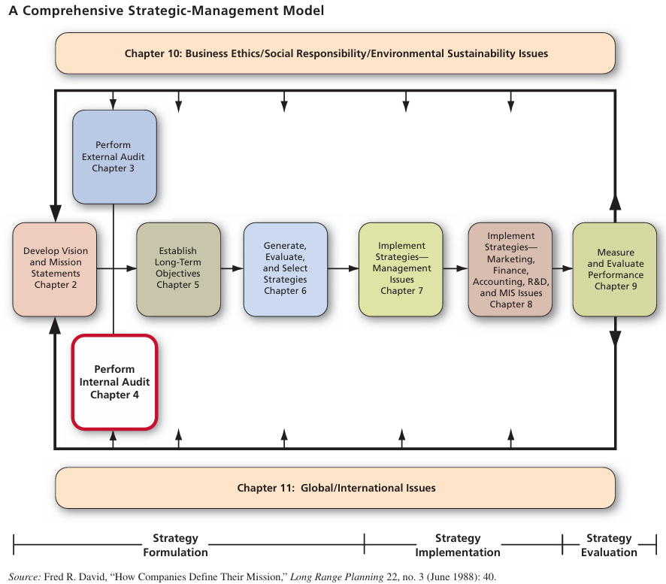

Slide 4
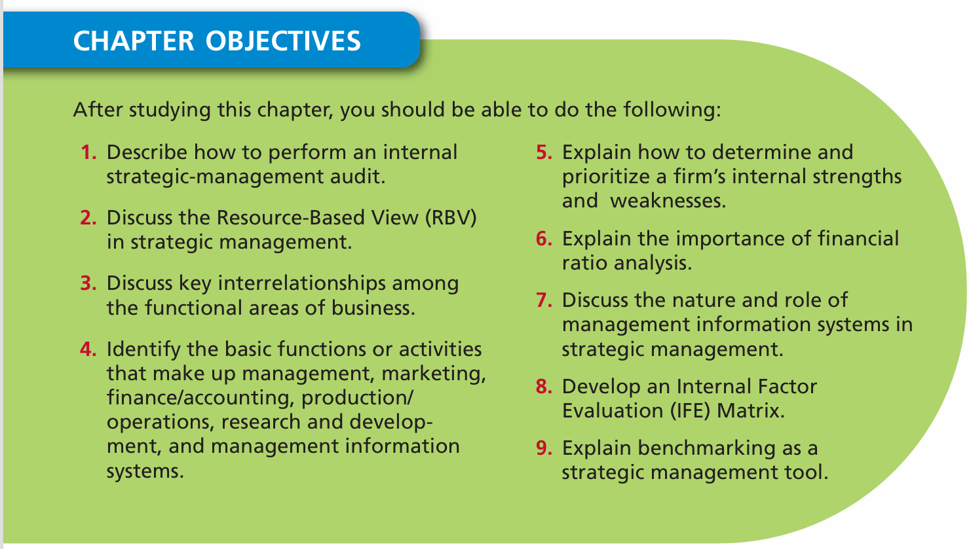

Slide 5
By thoroughly analyzing these internal dimensions, leaders are equipped to fine-tune strategy, allocate resources wisely, manage risks, and exceed performance expectations.
Purpose: Build a clear, evidence-based picture of internal capabilities, readiness, and constraints.
All organizations have strengths and weaknesses in the functional areas of business. No enterprise is equally strong or weak in all areas.
Maytag, for example, is known for excellent production and product design, whereas
Procter & Gamble is known for superb marketing.
Internal strengths/weaknesses, coupled with external opportunities/threats and a clear statement of mission, provide the basis for establishing objectives and strategies.

Slide 6
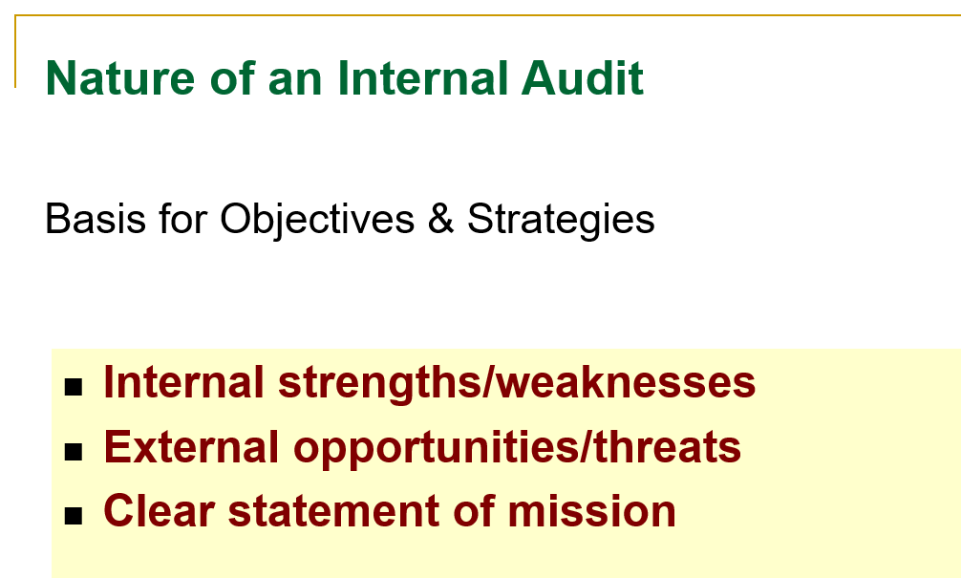
Module focuses on identifying and evaluating a firm’s strengths and weaknesses in the functional areas of business, including management, marketing, finance/accounting, production/operations, research and development, and management information systems.

Slide 7
Purpose of Internal Analysis
Uncover Internal Strengths & Weaknesses
• Identifies what the organization controls—its capabilities, assets, and limitations—to harness advantages and address vulnerabilities
Support Strategic Decision-Making
• Enables informed resource allocation, program prioritization, and operational adjustments based on factual internal insights
Establish Competitive Advantage & Viability
• Helps highlight core competencies—skills/resources that are valuable, rare, and hard-to-imitate—using frameworks like RBV/VRIO to build lasting competitive strengths
Optimize Performance & Resources
• Reveals relative cost structures, productivity gaps, and process inefficiencies compared to competitors—informing targeted improvements
Ensure Strategic Fit
• Gauges whether the organization's culture, structure, and capabilities align with its strategic goals for better strategy execution .
Proactive Risk Management
• Surfaces internal vulnerabilities so leaders can act before issues disrupt operations or strategic goals

Slide 8
The internal environment of an organization refers to the internal forces, conditions, and resources that influence its functioning and performance.

Slide 9
Nature of internal audit
1. Systematic and Structured Evaluation:
Internal audit is a process of examining and evaluating the organization’s internal controls, processes, and systems to ensure they align with organizational objectives.
2. Focus on Internal Controls and Risk Management:
Internal audit evaluates the effectiveness of internal controls designed to manage risks related to operations, finance, compliance, and information systems.

Slide 10
Enhances Corporate Governance:
Internal audit supports governance by ensuring policies, laws, and regulations are followed within the internal environment, promoting ethical and compliant business practices.
Continuous Monitoring and Improvement:
Internal audit is not a one-time exercise but a continuous activity that helps identify weaknesses, gaps, and inefficiencies within the internal environment and recommends improvements.
Adds Value to Strategic Decision-Making:
The insights from internal audit assist management in making informed decisions by understanding internal strengths and weaknesses better.

Slide 11
Key Internal Forces
Internal forces are the factors within an organization that influence its ability to achieve strategic goals. These forces form the internal environment, which can be assessed to understand the company’s strengths and weaknesses.

Slide 12
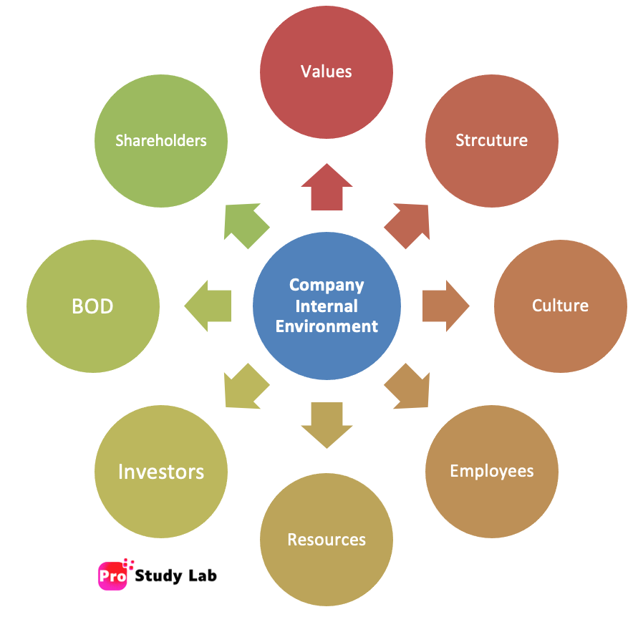
Major Key Internal Forces

Slide 13
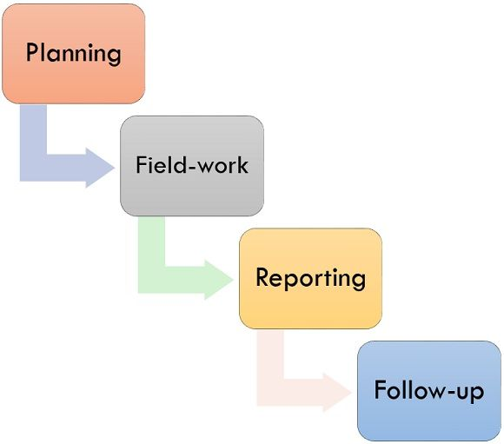
The Internal Audit Process

Slide 14
Planning:
In the course of the planning process, the audit team will describe the objectives and scope, evaluates instructions related to audit such as law, policies, procedures, etc. The audit plans are performed by analyzing the results from past audits and arranging a timetable.

Slide 15
2.Field-work:
It is a substantial act of internal auditing. During this stage, the audit team will start the audit process by reviewing supporting documents, interviewing department personnel, recognizing exceptions and identifying suggestions for improvement. In the end, the audit department furnishes written feedback and disciplinary action plan for their findings.

Slide 16
3. Reporting:
It is the third stage of the internal audit process. The auditor will formulate the internal audit report that sum-up and convey the audit results; then issues a draft report discussed with the unit management. After that, accurate, fair, short, and appropriate final report is issued by an auditor.

Slide 17
4.Follow-up:
It is the final and an important stage of internal audit which is generally ignored. In this stage, management must require time to time monitoring to achieve suggestions and findings determined during the internal audit process. Without proper and timely follow-up process management cannot expect any positive changes.

Slide 18
Resource-Based View(RBV)
The Resource-Based View (RBV) is a management tool used to determine the strategic resources of a firm to achieve sustainable competitive advantage.
This theory suggests that internal resources and capabilities of a firm are the main sources of competitive success.
RBV is an important tool for internal environmental analysis to assess the strengths of organization. Thus, it is used to assess organizational performance.

Slide 19
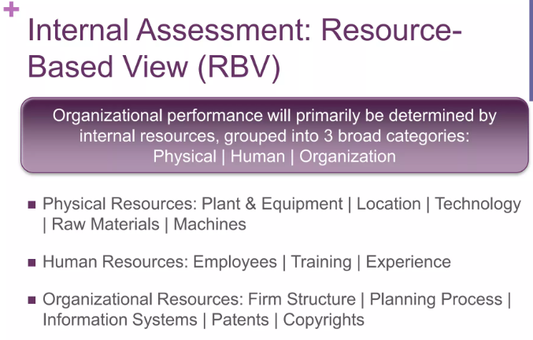

Slide 20
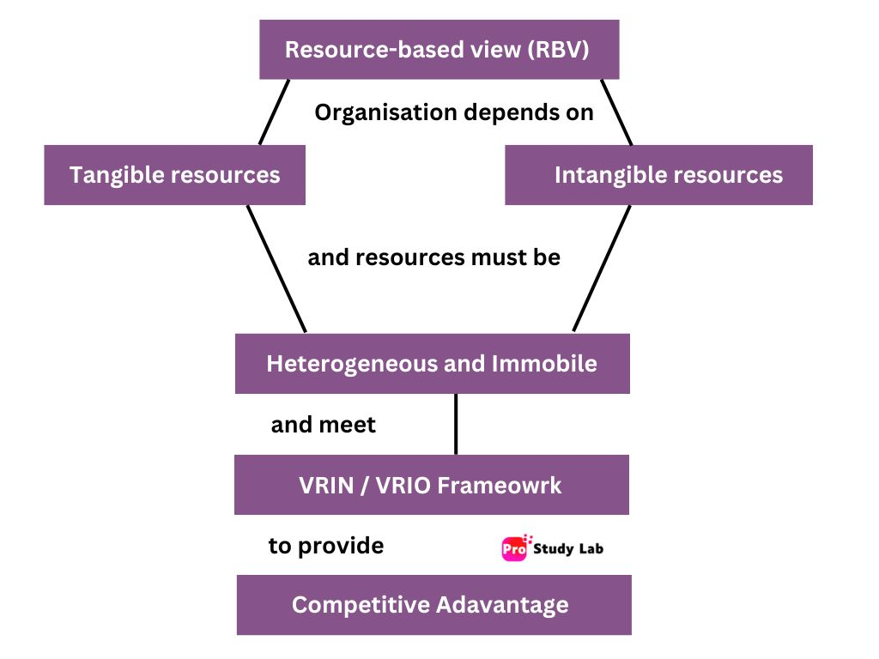

Slide 21
Tangible Resources
Things you can see or touch like:
Buildings
Machines
Money
Employees
2. Intangible Resources
Things you can’t see, but are very valuable like:
Brand name
Company culture
Patents
Knowledge
Reputation

Slide 22
RBV also considers that organizational resources should be heterogeneous and immobile.
Heterogeneous:
RBV states that companies should have different (heterogeneous) resources. If all firms have similar skills and capabilities, none can gain an advantage—this leads to perfect competition. Companies have unique resources, allowing them to create different strategies. These differences help firms stand out and gain a competitive advantage.

Slide 23
For example :
Apple and Samsung are exposed to the same market conditions in the external highly volatile environment but display different performances due to their heterogeneous resources. Apple produces smartphones and tablets with cutting-edge advanced technologies while selling them at higher profit margins, especially with its iOS. In contrast, Samsung relies on Google’s Android and says its product at a cheaper rate since it does not have access to the resources and technologies possessed by Apple that indicate the heterogeneity between the resources.

Slide 24
Immobile:
RBV assumes that resources are immobile, i.e. Do not move from one organization to another, at least in the short term. When resources are immobile, rivals cannot replicate other players’ resources in the industry to implement similar strategies. Intangible resources such as trademark brand equity, intellectual property, knowledge and process are immobile resources.
Good resources can’t be copied or bought easily by others.
Example: Coca-Cola’s secret formula.

Slide 25
VRIO framework
It is a strategic framework that helps organizations assess their internal resources and capabilities to identify potential sustained competitive advantages. By analyzing these four elements, companies can gain insights into their strengths and weaknesses and make informed decisions about how to allocate resources and develop their business strategies.

Slide 26
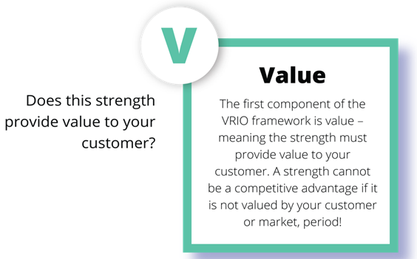
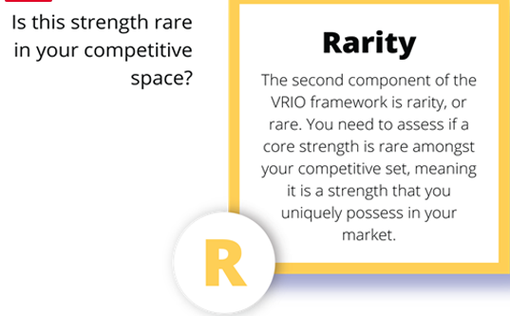
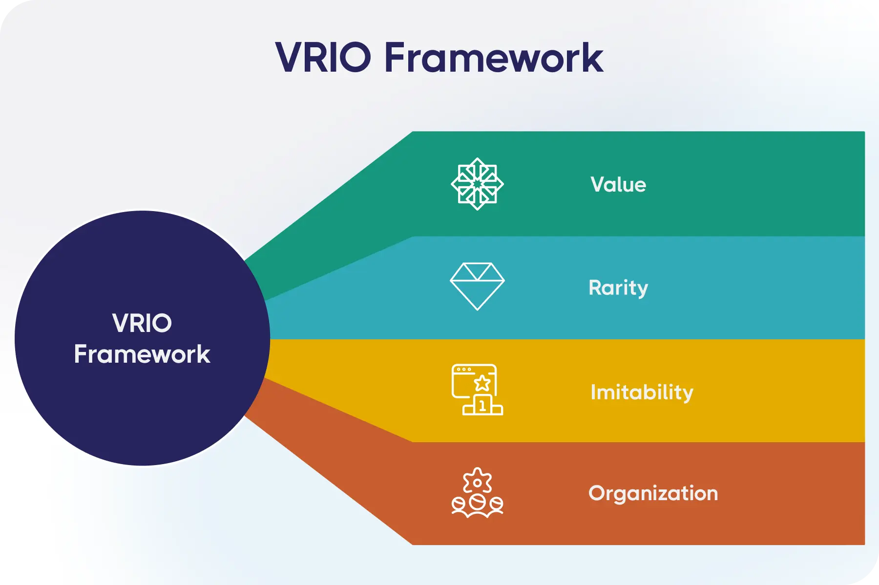
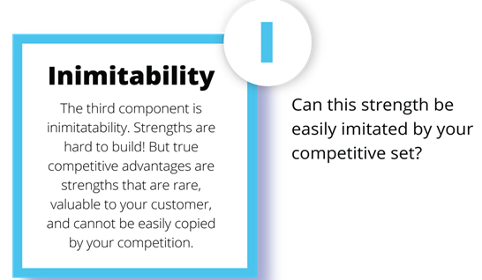
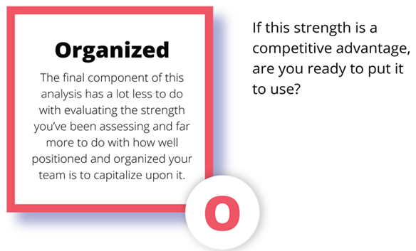

Slide 27
The VRIO framework is a strategic management tool used to evaluate a firm's resources and capabilities to determine their potential for achieving a sustained competitive advantage. It was first proposed by Jay Barney in 1991¹.
Key Principles
The VRIO framework stands for Value, Rarity, Imitability, and Organization. These four dimensions help in assessing the competitive potential of a resource or capability:
Value: This dimension evaluates whether a resource or capability enables a firm to exploit opportunities or neutralize threats in the marketplace. Valuable resources can increase revenues or decrease costs¹.
Rarity: A resource is considered rare if it is unique among current and potential competitors. Rare resources can lead to a competitive advantage if they are in short supply and persist over time¹.
Imitability: This dimension assesses whether firms without the resource face a cost disadvantage in obtaining or developing it. If a resource is costly to imitate, it can provide a sustained competitive advantage¹.
Organization: This evaluates whether a firm is organized to exploit the resource or capability effectively. This includes formal reporting structures, management control systems, and compensation policies¹.

Slide 28
Value
A resource is valuable if it helps the company to meet customer needs, improve quality, or lower costs. It gives the company a competitive advantage over others.
Rarity
A resource is rare if few competitors have it. Rare resources, like patents or unique skills, help a company stand out and gain a competitive advantage.

Slide 29
Imitability:
A resource has high imitability if competitors can easily copy it. If it’s hard to imitate, like a strong brand or unique process, it gives the company a lasting competitive advantage.
Organization:
Organization refers to how well a company is set up to use its resources effectively. A strong structure, culture, and processes help the firm fully benefit from valuable, rare, and hard-to-imitate resources.

Slide 30
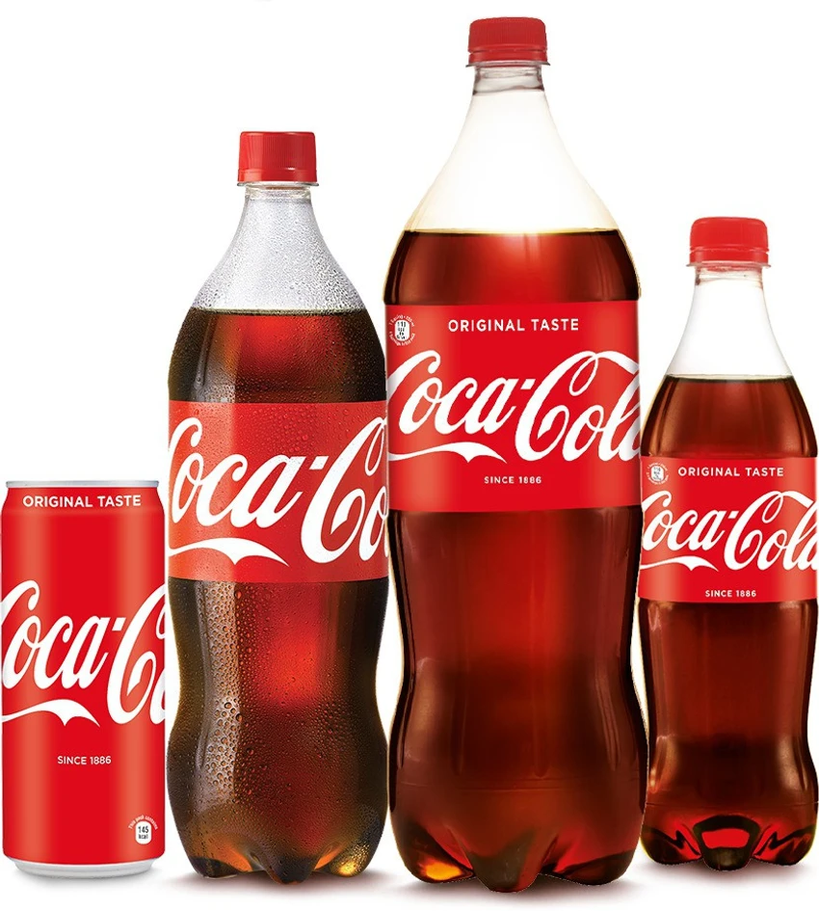
Case Study: Coca-Cola
Coca-Cola is a classic example of the Resource-Based View (RBV) in action, using its internal strengths to maintain global market leadership. Its most valuable and rare resource is its secret formula, which has remained unmatched in taste and brand appeal. Coca-Cola’s strong global brand equity, built over decades, is nearly impossible for competitors to imitate. In addition, its vast distribution network, marketing expertise, and bottling partnerships around the world show how well the company is organized to exploit these unique resources. By aligning its valuable, rare, and inimitable assets with a robust organizational structure, Coca-Cola continues to sustain a long-term competitive advantage in the beverage industry.

Slide 31
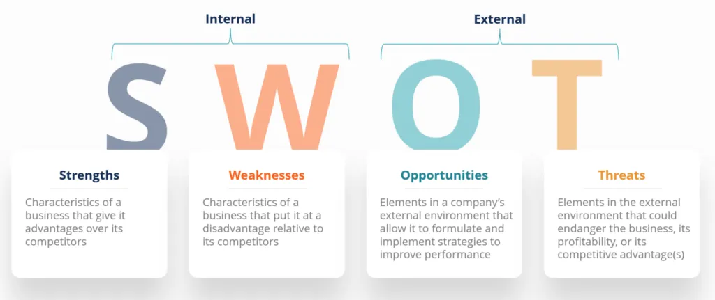

Slide 32

Amazon, the global e-commerce giant, is a perfect example of how SWOT (Strengths, Weaknesses, Opportunities, Threats) analysis helps a company understand its strategic position.
Strengths: Amazon’s key strengths include a strong global brand, vast product selection, advanced logistics network, and technological leadership in cloud computing through Amazon Web Services (AWS).

Slide 33
Weaknesses: Despite its size, Amazon faces criticism for thin profit margins in its retail segment, dependency on third-party sellers, and negative publicity around employee working conditions.
Opportunities: Amazon has significant opportunities in expanding its physical retail presence, entering emerging markets like India, and investing in AI and drone delivery to improve customer experience.
Threats: The company faces threats from increasing global competition (like Walmart, Alibaba), changing government regulations, cybersecurity risks, and economic slowdowns that may impact consumer spending.

Slide 34
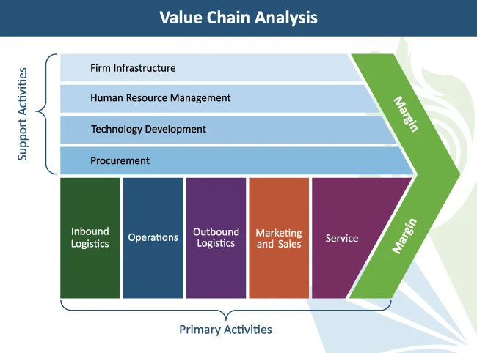

Slide 35
Case Study
Value Chain Analysis of Tata Motors
Tata Motors, a leading Indian automobile manufacturer, effectively uses Value Chain Analysis to enhance efficiency and maintain competitiveness in the global market. In the inbound logistics stage, Tata Motors benefits from long-term supplier relationships and localized sourcing of components, reducing costs. Its operations are streamlined through advanced manufacturing plants across India, such as those in Pune and Sanand, ensuring efficient production.

Slide 36
In outbound logistics, Tata Motors uses a strong distribution network and dealerships to reach customers in domestic and international markets. Its marketing and sales efforts focus on brand positioning, affordability, and innovation—especially in electric vehicles like the Tata Nexon EV. After-sales services, including warranty, maintenance, and customer care, add value and build customer loyalty. Support activities like technology development through R&D centers and human resource management further strengthen Tata Motors' ability to innovate and stay competitive. Overall, Tata Motors’ value chain strategy enables it to deliver quality vehicles at competitive prices while sustaining profitability and customer satisfaction.

Slide 37
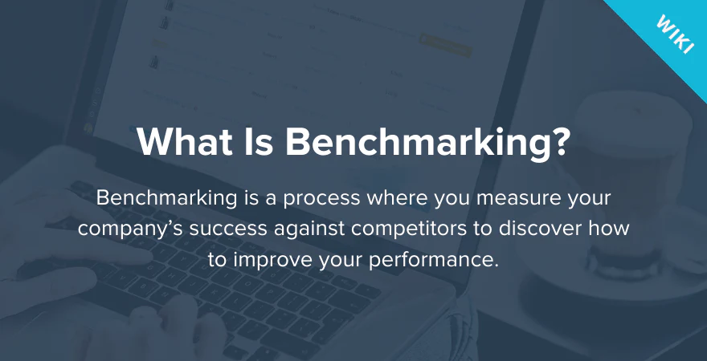

Slide 38
Example: Benchmarking at Samsung
Samsung, in its journey to become a global leader in electronics, benchmarked Apple’s product design, innovation strategy, and customer experience. By studying Apple’s sleek product aesthetics, intuitive user interface, and ecosystem integration, Samsung redesigned its smartphone models (like the Galaxy series) to compete more effectively. This benchmarking helped Samsung improve quality, increase customer satisfaction, and become a major player in the premium smartphone segment.

Slide 39
Internal Factor Evaluation Matrix (IFE Matrix)
The Internal Factor Evaluation (IFE) Matrix is a strategic management tool used to assess a company’s internal strengths and weaknesses. It helps quantify these factors and determine how well the firm is utilizing its internal resources and managing its limitations.

Slide 40
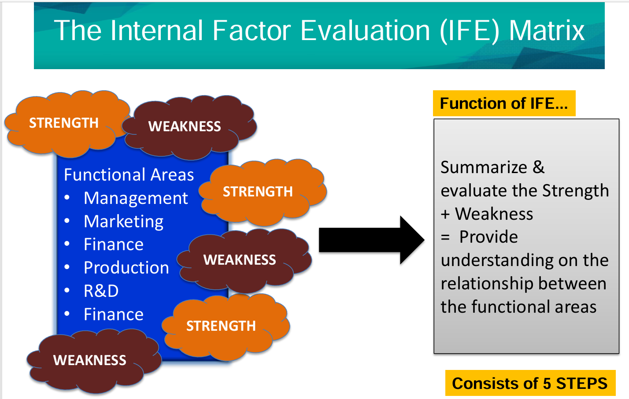

Slide 41
Steps to Create an IFE Matrix:
List Key Internal Factors – Identify 5–10 strengths and 5–10 weaknesses.
Assign Weights – Each factor is given a weight from 0.0 to 1.0 (totaling 1.0 overall), based on its importance.
Assign Ratings – Each factor is rated on a scale from 1 to 4
  4 = Major Strength
  3 = Minor Strength
  2 = Minor Weakness
  1 = Major Weakness
Calculate Weighted Score – Multiply the weight by the rating for each factor.
Add the Scores – The total score indicates the internal strength of the firm.
Total score > 2.5: Strong internal position
Total score < 2.5: Weak internal position

Slide 42
Internal Factors | Weight | Rating | Score
Strong brand recognition | 0.20 | 4 | 0.80
Wide network of outlets | 0.15 | 3 | 0.45
Affordable pricing | 0.10 | 3 | 0.30
Poor financial management | 0.20 | 1 | 0.20
Limited international presence | 0.15 | 2 | 0.30
Declining customer experience | 0.20 | 1 | 0.20
Total | 1.00 |  | 2.25

Slide 43
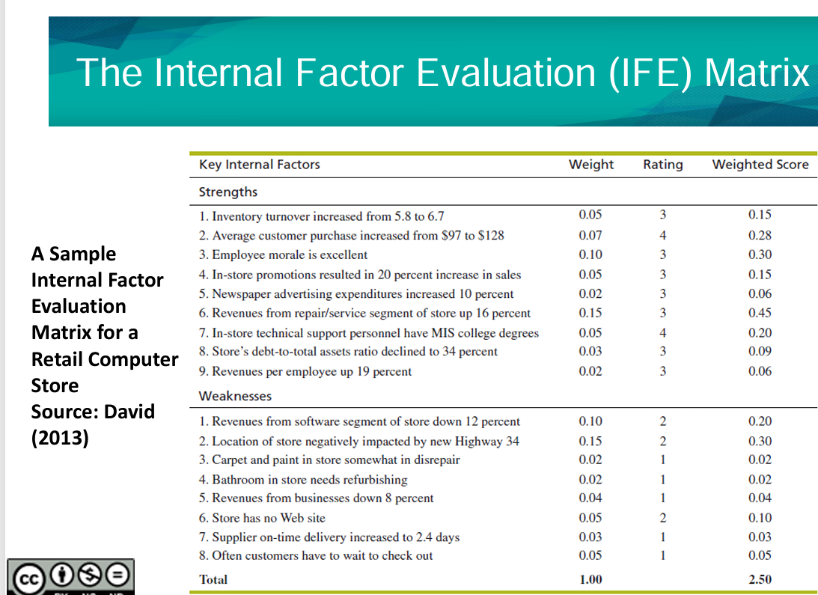

Slide 44
Interpretation:
With a total weighted score of 2.25, Café Coffee Day has a below-average internal position, indicating that while it has some strengths, major weaknesses like poor financial health and customer experience need urgent attention.

Slide 45


Slide 46
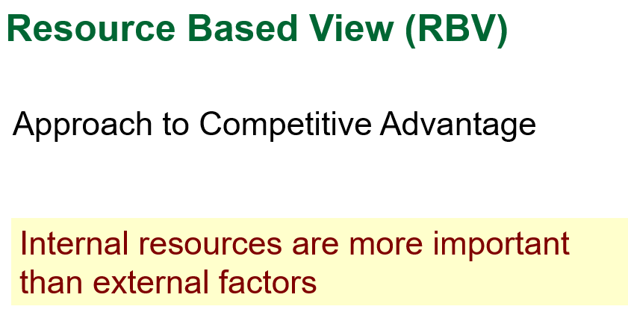
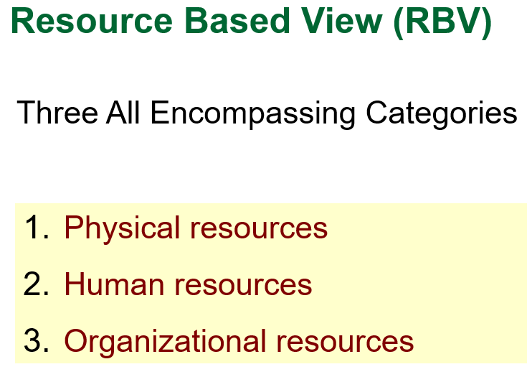

Slide 47
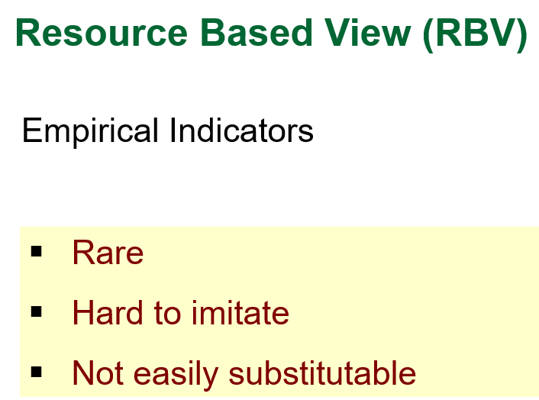

Slide 48
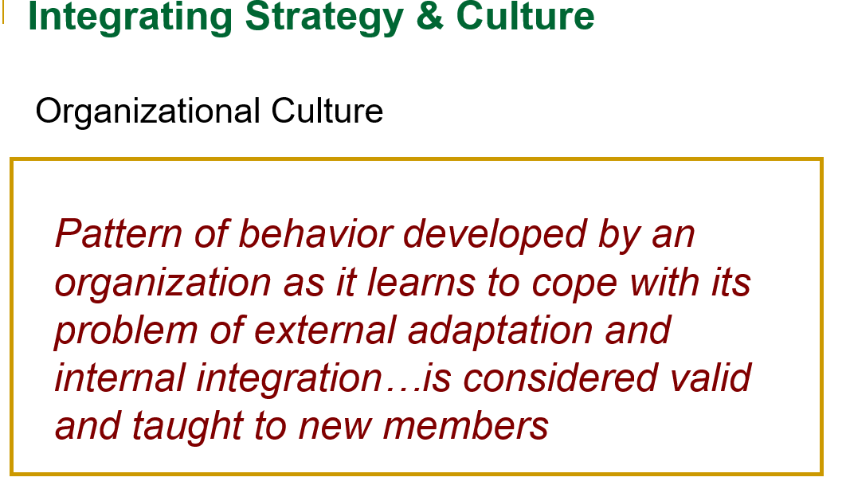
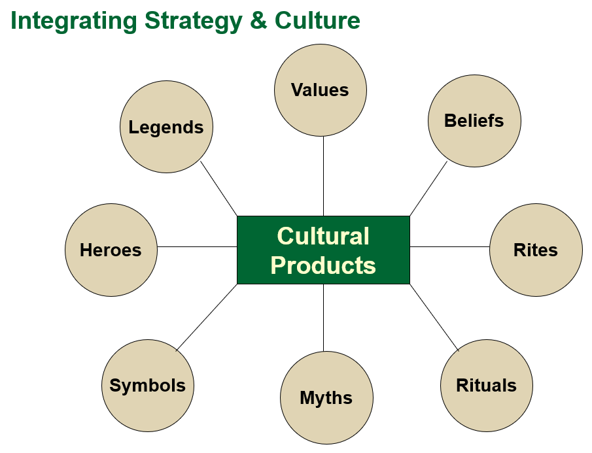

Slide 49
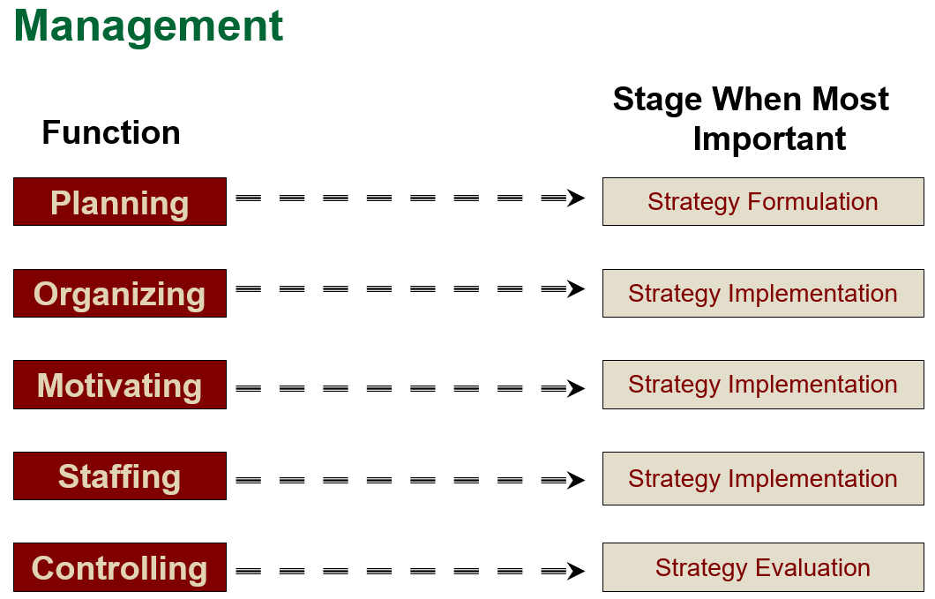

Slide 50
https://ocw.ump.edu.my/pluginfile.php/630/mod_resource/content/1
Error

Slide 51
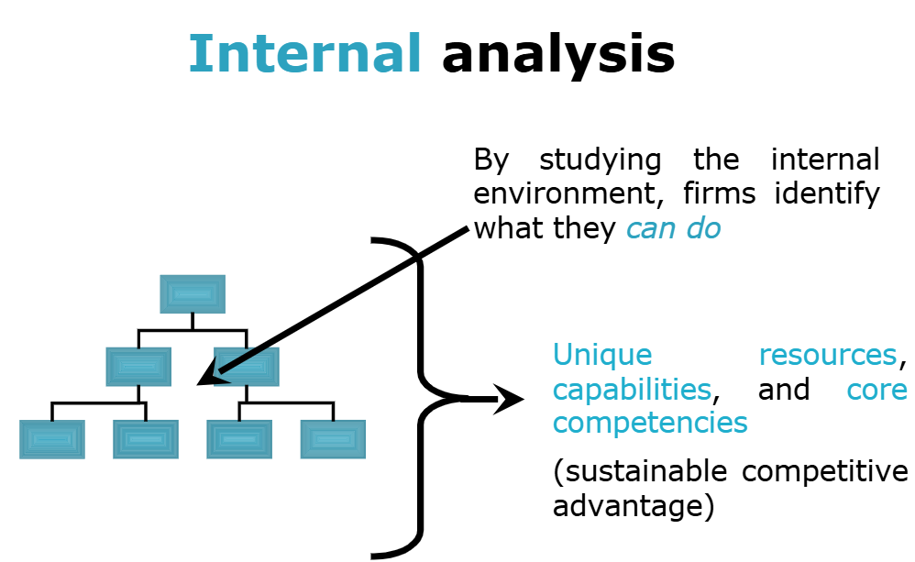
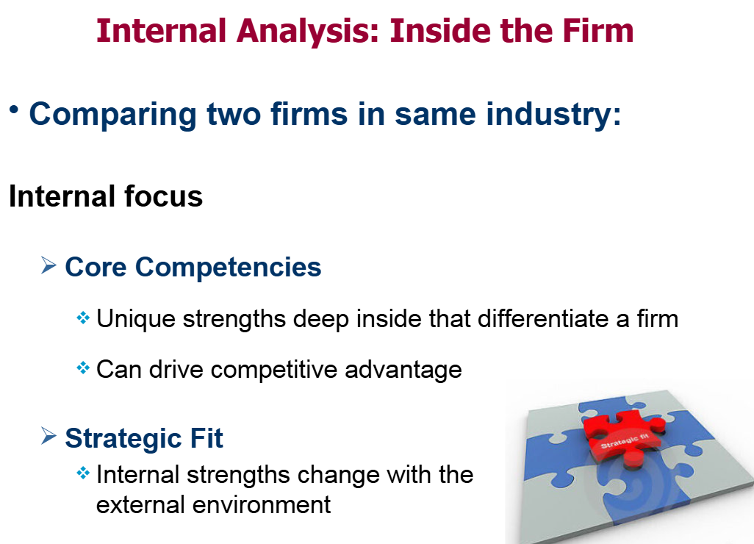
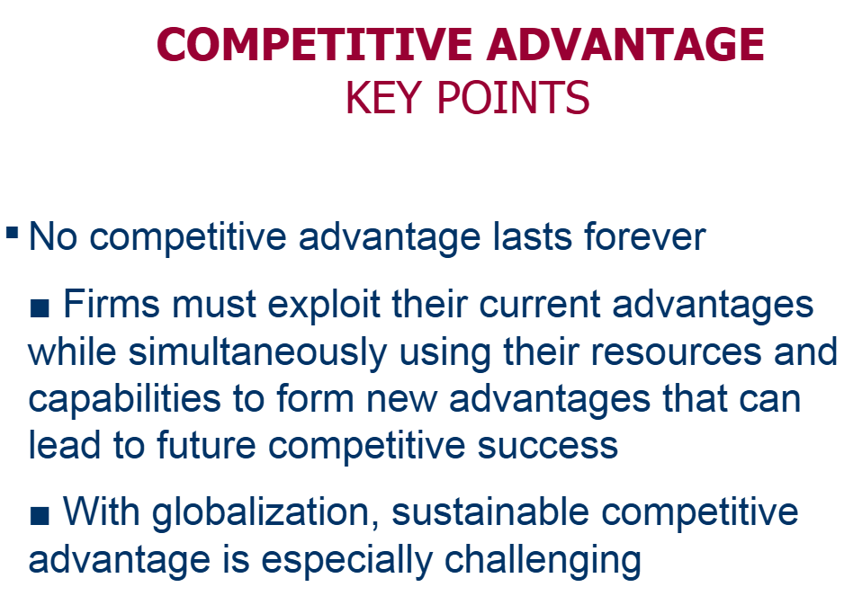

Slide 52
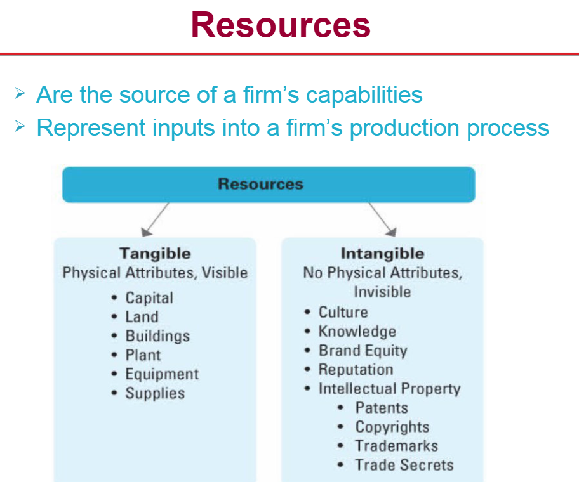

Slide 53
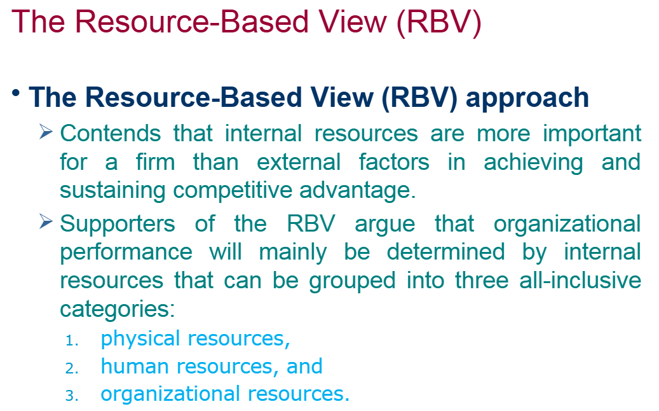
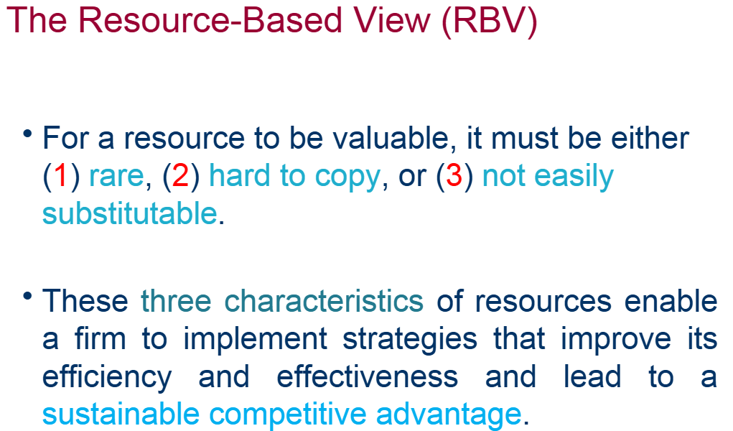

Slide 54
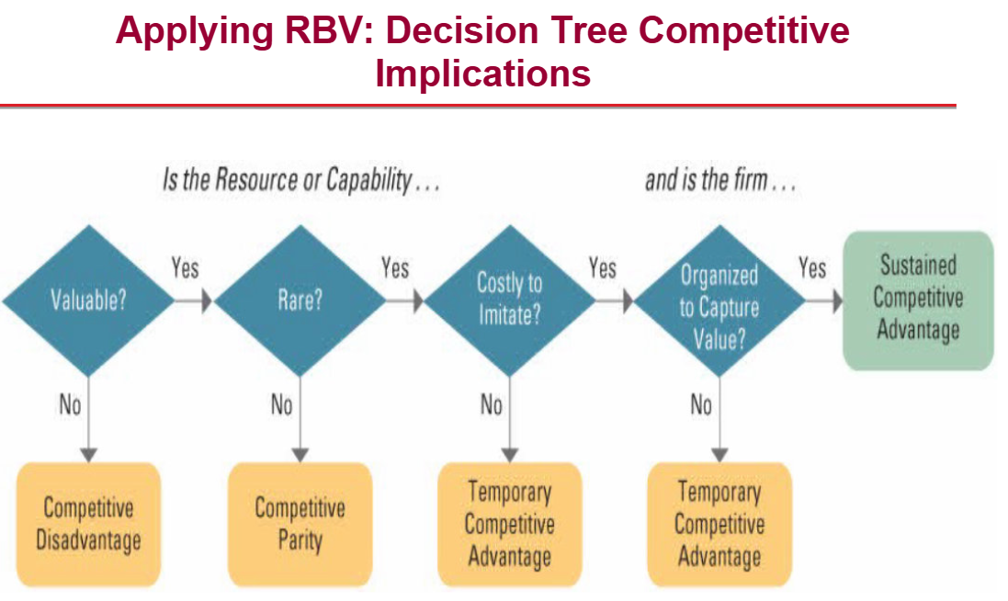

Slide 55
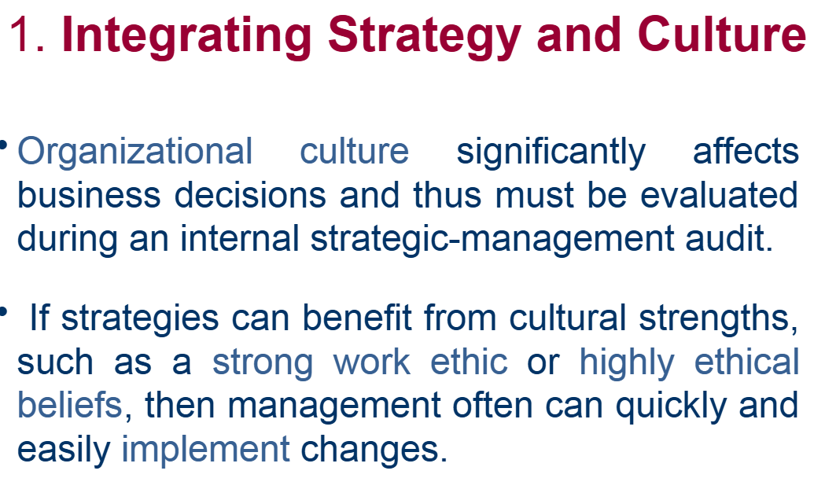
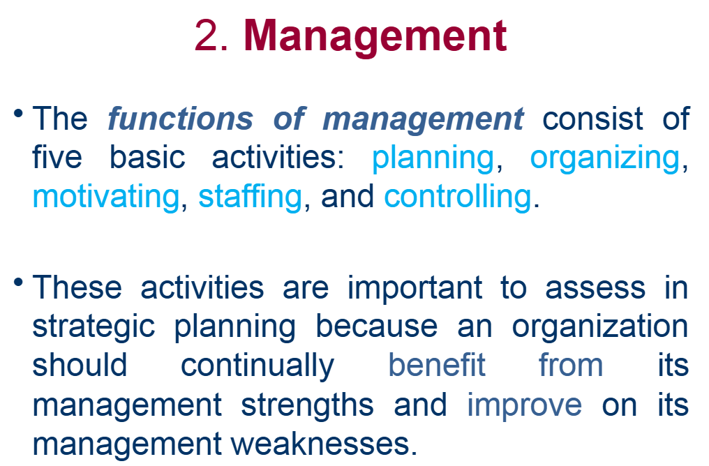

Slide 56
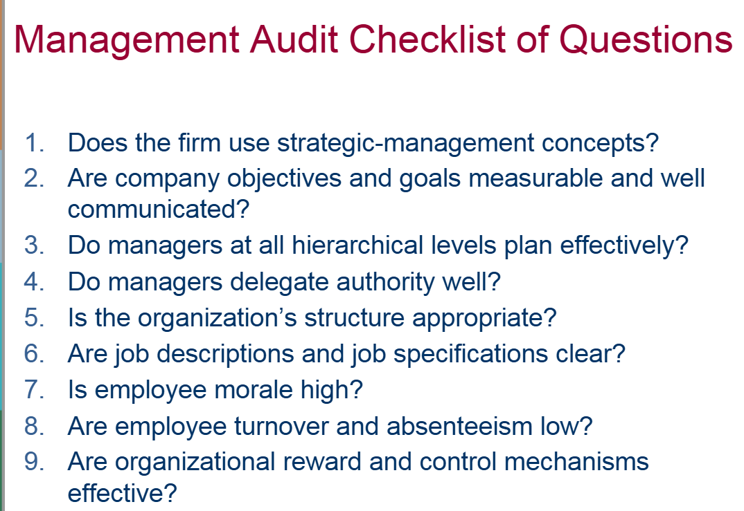

Slide 57
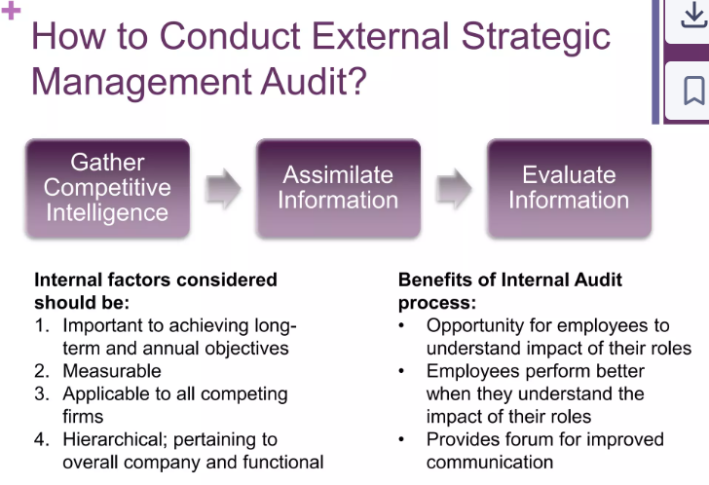

Slide 58
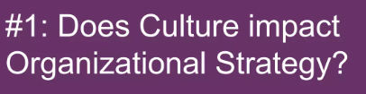
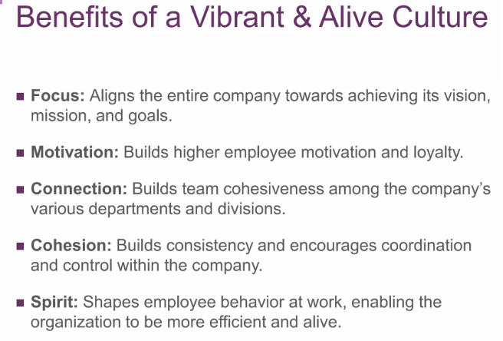

Slide 59
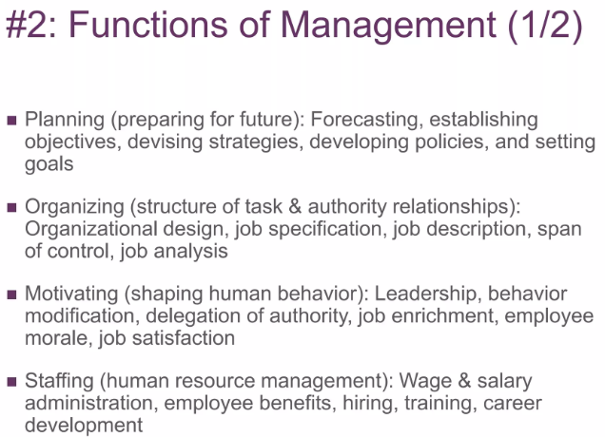
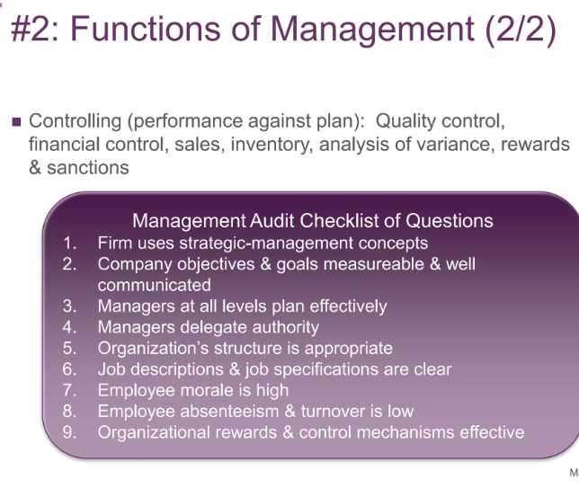

Slide 60
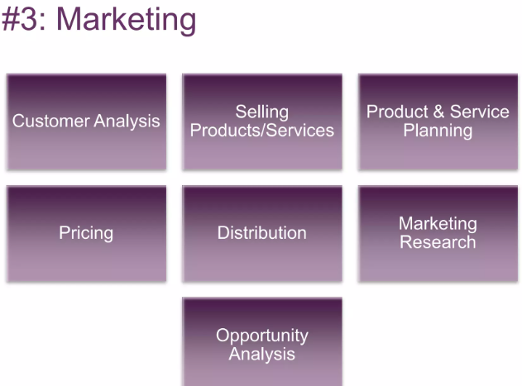
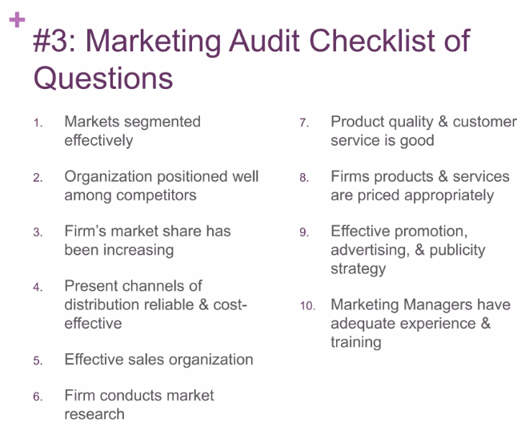

Slide 61
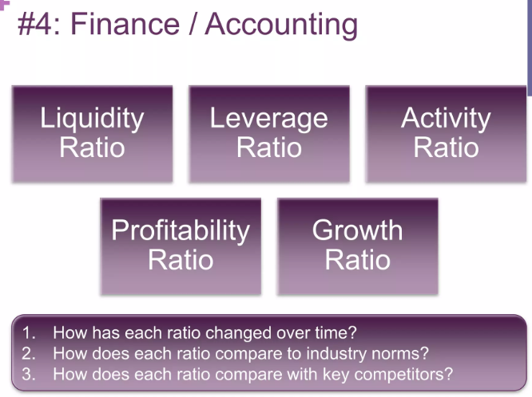
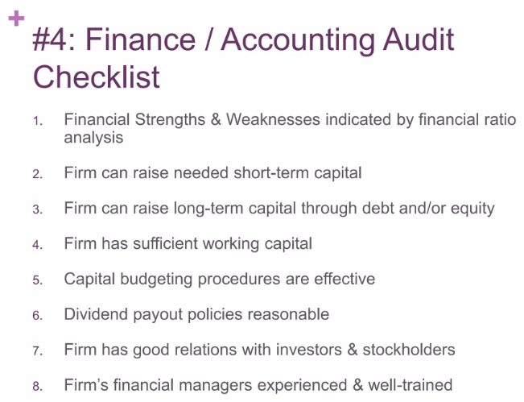

Slide 62
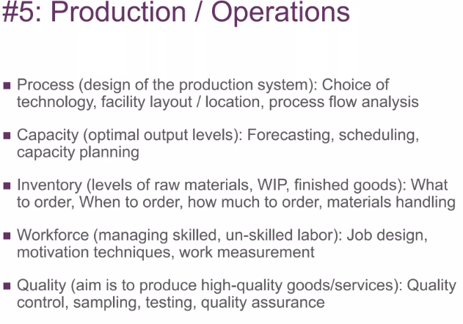
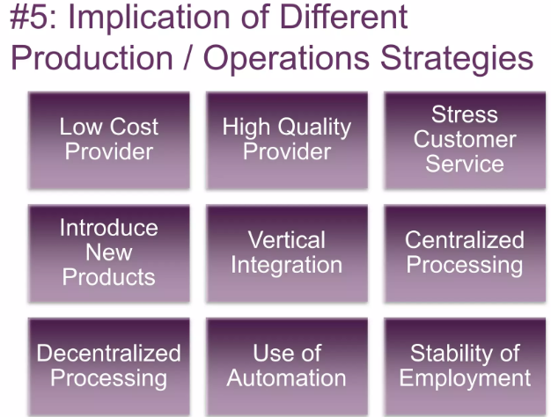
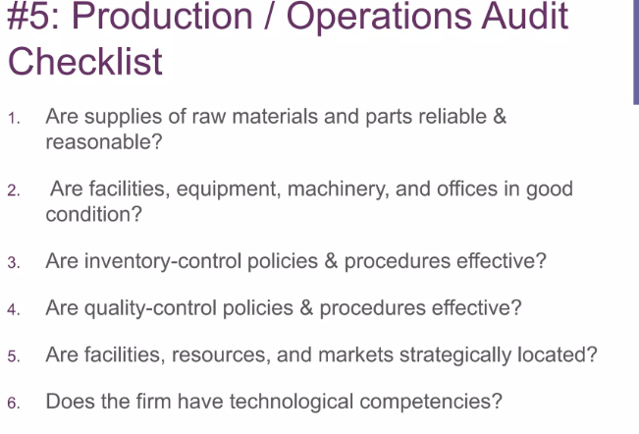

Slide 63

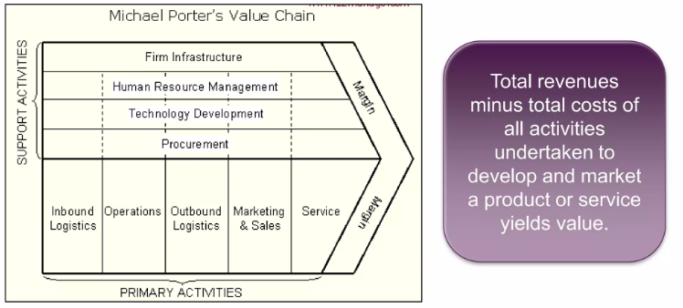

Slide 64
